Slide 1





Blood Group Identification
TEAM 4
Advanced Identification System for Blood Group Detection

Slide 2
Introduction
Background: Blood group identification is critical in medical fields, especially in emergencies, surgeries, and blood transfusions. The need for rapid and accurate blood group detection is crucial to prevent complications arising from incompatible blood transfusions.
Problem Statement: Traditional blood group identification can be time-consuming, requiring trained personnel and specialized equipment. Our project aims to create a more efficient and accessible solution.
Project Objective: This project focuses on developing an identification system that quickly and accurately classifies ABO and Rh blood groups, enhancing the response time in healthcare settings.

Slide 3
Project Milestones – Blood Group Identification System
Milestone 1 :
The first milestone focuses on creating a user-friendly interface, which includes the homepage, login page, registration page, and profile page. These pages form the backbone of user interaction, allowing seamless access and easy navigation through the system. The homepage introduces users to the project’s purpose, while the login and registration pages ensure secure and personalized access. The profile page, specifically, is designed for uploading image ABD blood cell image and submitting them for blood group identification. This foundational milestone ensures users have a clear and secure entry point into the system.

Slide 4
Project Milestones – Blood Group Identification System
Milestone 2 :
In Milestone 2, we dived deeply into OpenCV in Python, exploring its core functions and capabilities. We thoroughly discussed its potential applications for our project, focusing on image processing, computer vision techniques, and how OpenCV can be leveraged to meet the project's requirements. Through practical examples, we have gained a solid understanding of how to integrate OpenCV effectively, ensuring it enhances the functionality and performance of our project in the most optimal way.

Slide 5
Project Milestones – Blood Group Identification System
Milestone 3 :
In Milestone 3, we successfully implemented the OpenCV logic for our project to detect and calculate the contour length of an uploaded image. Using techniques such as edge detection, thresholding, and contour finding, we were able to extract and analyze the contours present in the image. Once the contours were identified, we computed the length of each contour and displayed the results to the user in a clear format. This milestone marks a key step forward in demonstrating the practical application of OpenCV for image analysis within our project.

Slide 6
Project Milestones – Blood Group Identification System
Milestone 4 :
In Milestone 4, we have successfully implemented the OpenCV logic for determining the blood group type from the uploaded image has been successfully implemented. The system now processes the image and displays the identified blood group type on the output page as expected.

Slide 7
System Architecture
User Interaction via Browser
Image Upload Authentication
Frontend (HTML/CSS)
Counter Analysis & Blood Group Detection
Django Server
Login Successful
Image Processing ( OpenCV )
User ( Login )
New User
Result Display
User ( Register )

Slide 8
OVERVIEW
Customer Features
User Registration
New users can create accounts for personalized access.
Login System
Existing users can securely log in to access their profile and features.
Uploading Images !
Users can upload ABO and Rh blood cell images for blood group analysis.
Identification Results
After uploading images, users receive a detailed blood group identification result.

Slide 9
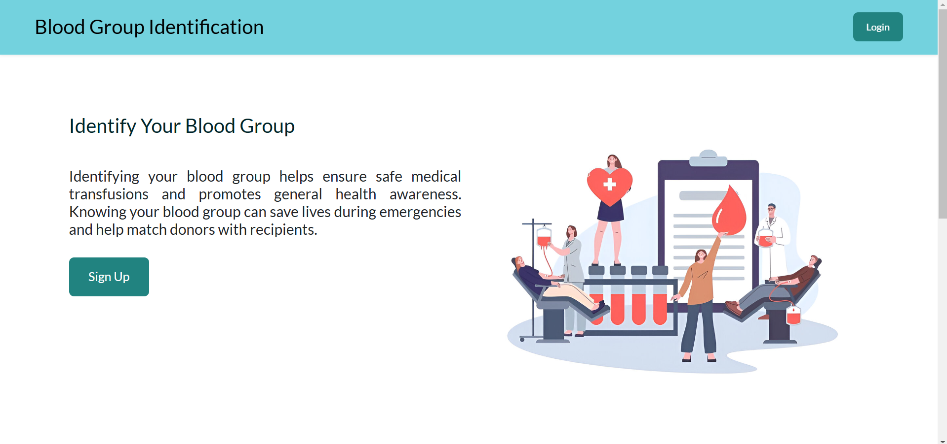
PROJECT VISUALS
HOME PAGE

Slide 10
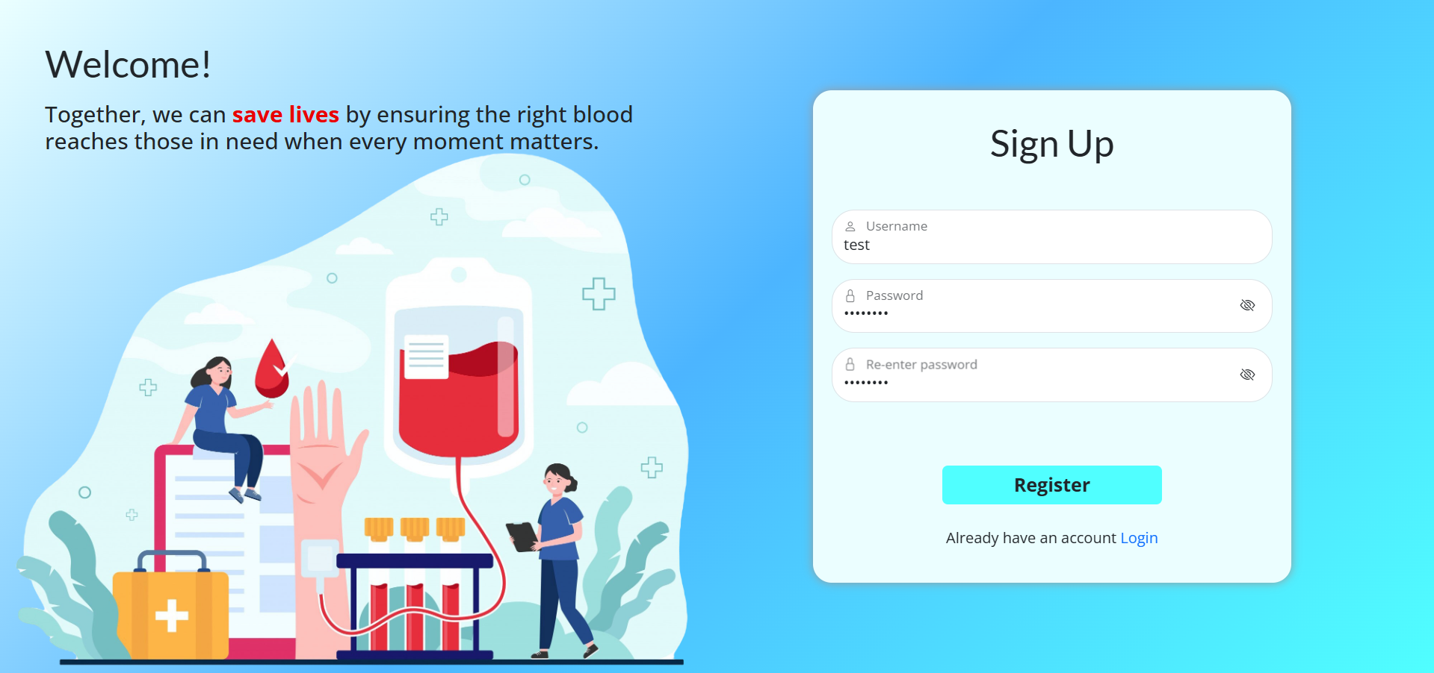
PROJECT VISUALS
SIGN UP PAGE

Slide 11
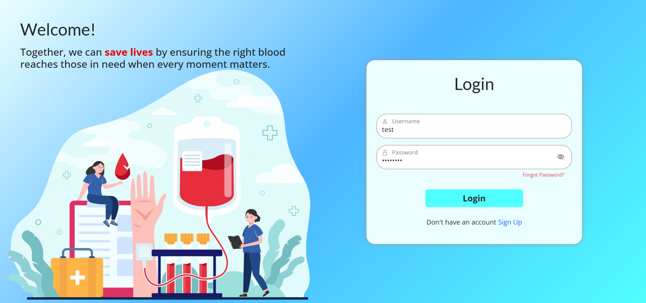
PROJECT VISUALS
LOGIN PAGE

Slide 12
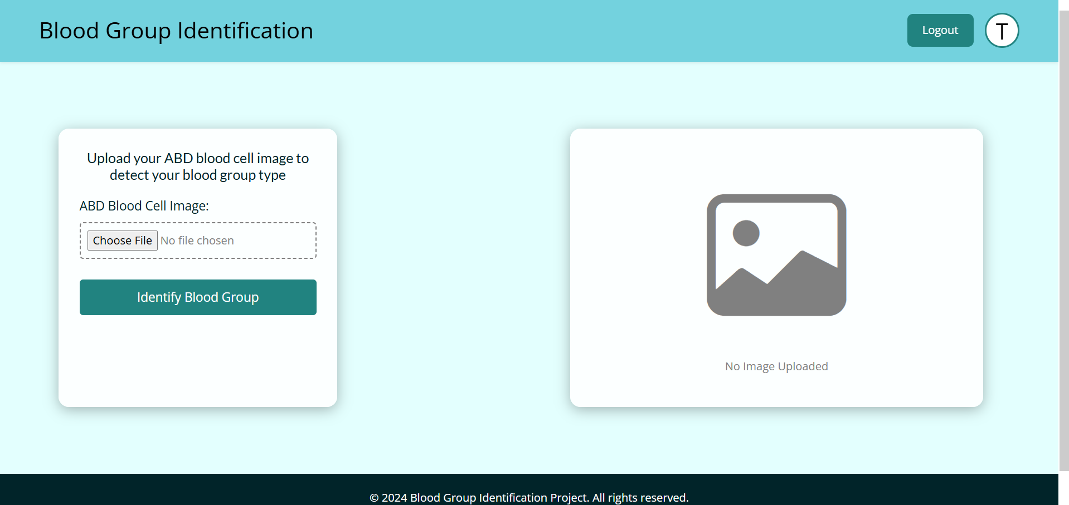
PROJECT VISUALS
PROFILE PAGE

Slide 13
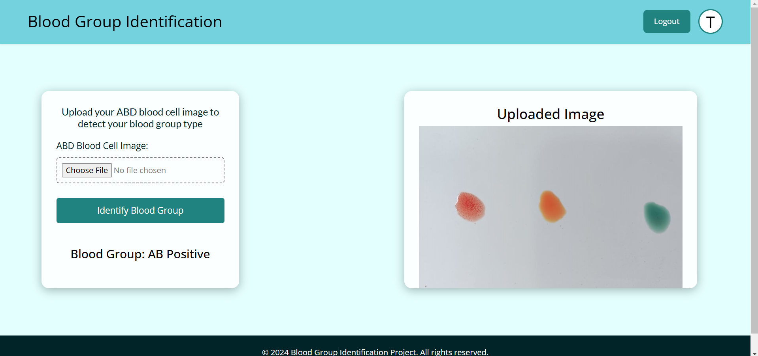
PROJECT VISUALS
OUTPUT PAGE

Slide 14
CONCLUSION
In this project, we successfully developed a system for identifying blood groups based on a user's uploaded image of ABD blood cell. By leveraging OpenCV for image processing, the system performs several steps such as image enhancement, thresholding, morphological operations, and region-based analysis to determine the blood group type. This solution efficiently processes the image and provides an accurate blood group identification.

Slide 15
FUTURE ENHANCEMENTS
Machine Learning Integration
Implement deep learning models (e.g., CNNs) for better accuracy and handling of diverse image qualities.
Multi image and Batch Processing
Enable multi-image analysis for batch processing and cross-referencing multiple samples.
Cloud Integration
Store results on the cloud for easy access and provide centralized databases for healthcare providers.

Slide 16
Team Members 1. Shashank Anand Gedela 2. Reddy Chandu B S
Each team member played an integral role in the successful development and completion of this project.
Teamwork made this project possible.
Each Member have worked on each part of the project.

Slide 17
Thank you

